Slide 1
Granite School District Crosspointe Gradebook Parent/Student Portal
Questions?? Contact: Karen Tohinaka Craig Schow Information Systems Information Systems Gradebook Administrator Programmer Ph# (385) 646-4168 Ph# (385) 646-7438 kttohinaka@graniteschools.org cschow1@graniteschools.org

Slide 2
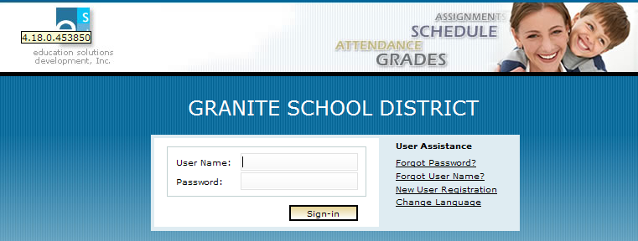
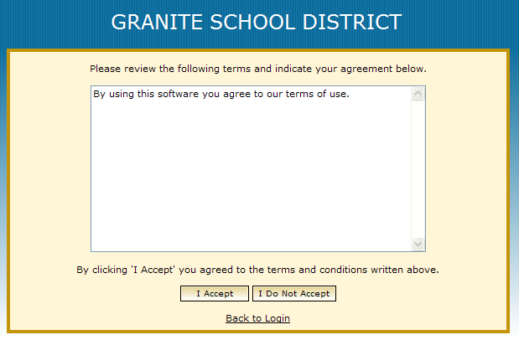
Accessing The Parent/Student Portal
In a supported Internet browser, enter the URL:
https://gb.graniteschools.org/portal/
At the portal sign-in:
If you are setting your username up for the 1st time, click New User Registration.
You can also change the Language you want to read this in by clicking Change Language.
Click I Accept

Slide 3
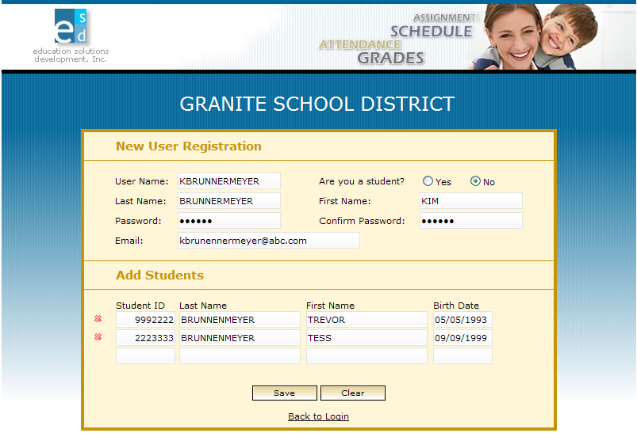
Setting Up Your Account
1. Enter your information into the following fields under New User Registration:
User Name
Last Name
Password (at least 6 characters)
Confirm Password
Email
2. Choose Yes, if you are a student setting up your gradebook portal or No, if you are a parent setting up your gradebook portal to see your child’s grades.
4. To Delete a Student’s info, click the red X next to the Student’s name
3. Type in the student info into the following fields under Add Students:
Student ID
Last Name
First Name
Birthdate
(If you have more than 1 child enrolled in this district, you can add them after you complete the registration process, using the Miscellaneous menu option).
5. Click SAVE when you have entered info needed.

Slide 4
Setting Up Your Account (Cont.)
The Portal validates your entries then displays the message: “Save Successful-A Confirmation Key has been sent to your email. Click here to login.”
Check your email to retrieve your confirmation key. Enter it in the Confirmation Key field, then click the Sign- in button. If you lose it, contact the school to receive your verification key.
Then the Sign-in screen is redisplayed. Now enter your user name and password you set up, then click Sign-in.

Slide 5
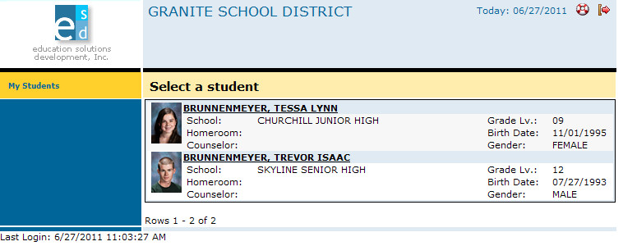
For Parent View
If you are a parent and you have more than one child enrolled in the school district, the Portal displays a list of your children. Click on the underlined name of your child whose information you want to see and it will give you a menu list to the left of the screen to choose from.
Click here to log out
To redisplay the list of your children, at any time, click the My Students option.

Slide 6
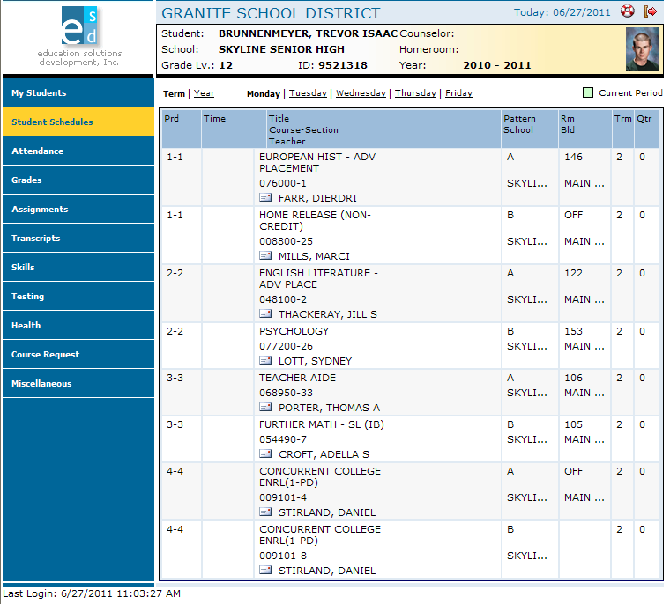
Student View
If you are a student or a parent with only one child enrolled in the school district, the Portal displays the Student Schedule screen. The My Student option is not displayed. Click a Menu Option to display the information you wish to view.

Slide 7
For Parents, Guardians, and Students
Daily Schedule of Classes:
Click the Student Schedules menu option.
The Portal displays a chart showing all the classes by period for this term.
To see the schedule for the entire year, click Year.
To see the schedule for a different day, click the underlined day.

Slide 8
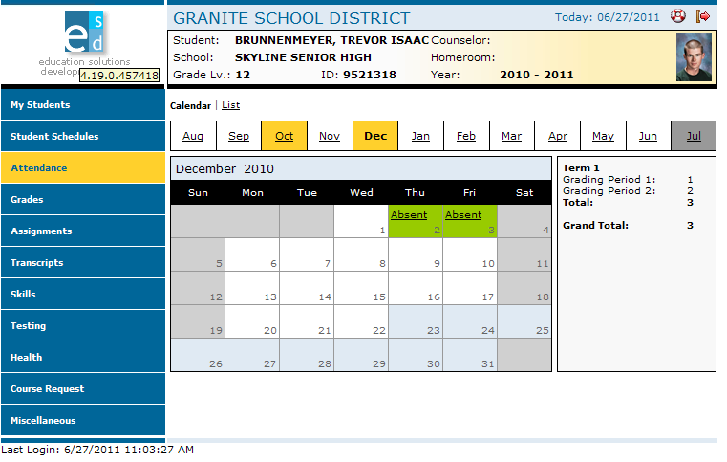
Attendance Information by Month:
Click the Attendance menu option.
The Portal displays a calendar that shows absences and tardies.
To see a list of tardies, click list.
Months that include one or more absences are highlighted in yellow.

Slide 9
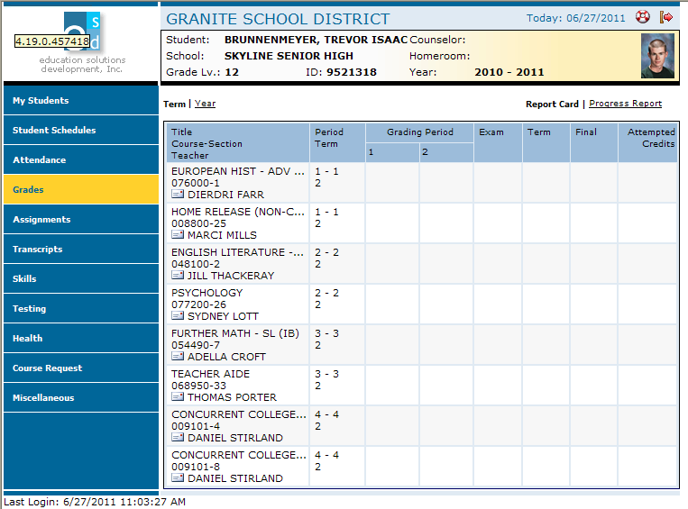
Grades Information:
Click the Grades menu option
The Portal displays the grades for each grading period for each class for the current term.
To see the grades for the entire year, click Year.
To see grades reported on the progress report, click Progress Report.
Click on the envelope next to teachers name to send email to teacher.

Slide 10
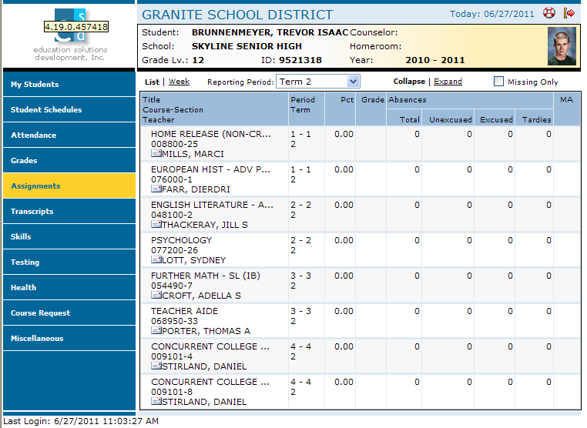
Assignments For Each Class:
Click the Assignments menu option.;
The Portal displays a list of classes, along with basic grade and attendance information.
To see a list of assignments for the current week, click Week.
To see a list of missing assignments, click the check box by Missing Only.
Click on the envelope to send email to teacher
To see a comprehensive list of all assignments for each class, click Expand.

Slide 11
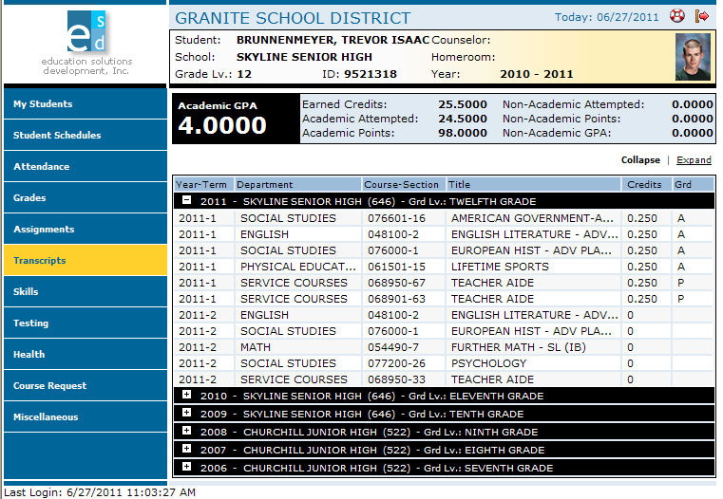
Transcript Information For each School year Enrolled:
Click the Transcripts menu option.
The Portal displays a list of classes, including credits and grades received.
To see the details for every year recorded in the transcript, click Expand.
To see more information for a different year, click the plus sign (+) that appears to the left of the year.

Slide 12
Skills Information:
Click Skills menu option.
The Portal displays a list of assessed skills and coordinating scores.

Slide 13
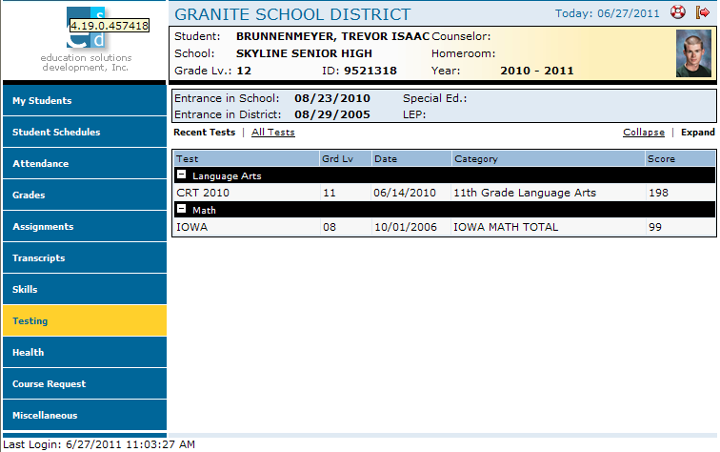
Standardized Test Scores:
Click the Testing menu option.
The Portal displays a list of recently taken standardized tests and coordinating scores.
To see details of all tests and scores, click Expand.

Slide 14
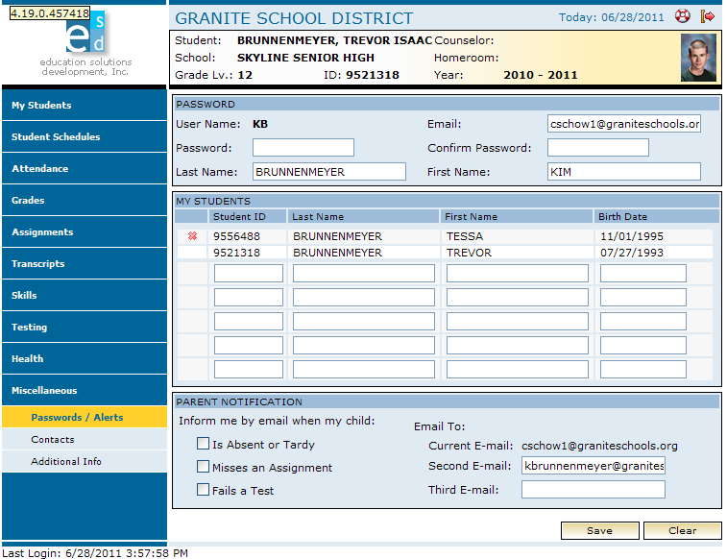
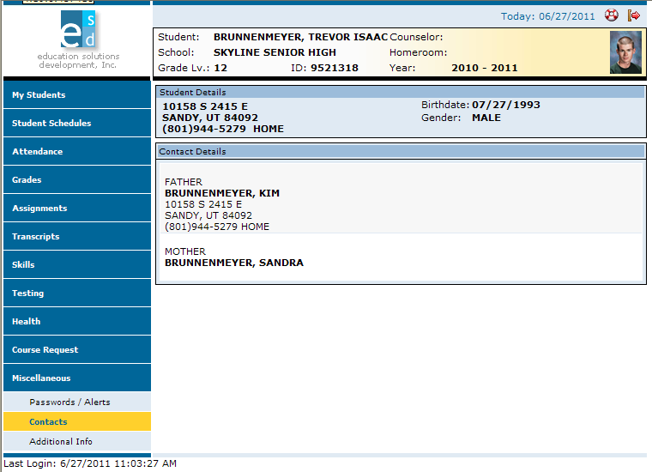
Miscellaneous:
Click the Miscellaneous menu option.
The Portal displays t
+wo additional menu options.
If any information is incorrect here,
you cannot change it. Parents will need to
contact the school for any updates or
changes to the information listed.
1. This page is where you can change your password and add additional children to be able to view their grades and info.
3. Contacts displays the student’s address and phone number at the top of the screen. Addresses and phone numbers for parents, guardians, and emergency contacts displayed below. Changes to any information cannot be made here but through your school office.
2. The option for email notification are listed in the bottom of the screen in the parent Notification section.
4. Click Save button after making any changes.

